Slide 1
Understanding the Supply Chain

Slide 2
Learning Objectives
Discuss the goal of a supply chain, and explain the impact of supply chain decisions on the success of a firm.
Identify the three key supply chain decision phases, and explain the significance of each one.
Describe the cycle and push/pull views of a supply chain.
Classify the supply chain macro processes in a firm.

Slide 3
What is a Supply Chain?
Supply chain: Consists of all parties involved, directly or indirectly, in fulfilling a customer request
Includes transporters, warehouses, retailers, and even customers
Functions include new product development, marketing, operations, distribution, finance, and customer service

Slide 4
The customer - An integral part of the supply chain
The primary purpose –To satisfy customer needs and, in the process, generate profit for itself.
It is important to visualize information, funds, and product flows along both directions of the chain
Most supply chains are actually networks. Thus, It may be more accurate to use the term supply network or supply web

Slide 5
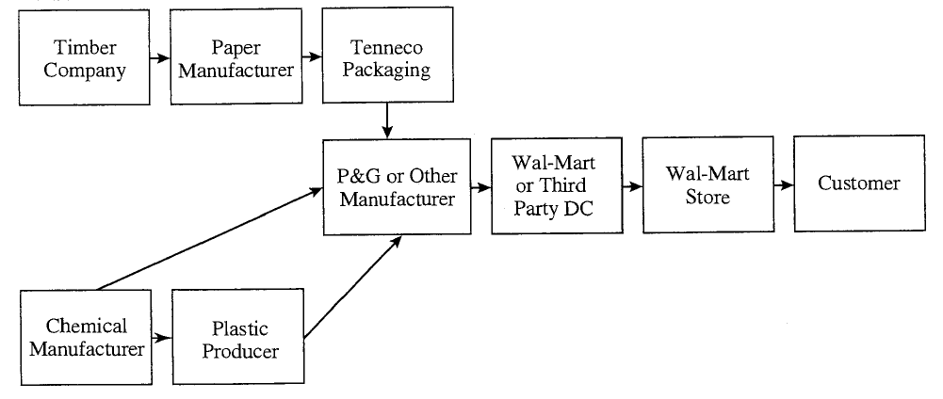
Example: When a customer asks for detergent at Wal-Mart, the following type of chain may be involved.
Figure 1-1

Slide 6
Different stages of typical supply chain:
customers, retailers, distributors, manufacturers, suppliers
Each stage is connected through the flow of products, information, and funds
Each stage may not be present
The appropriate design of the supply chain depends on both the customer's needs and the roles played by the stages

Slide 7
Example: Dell builds-to-order; that is, a customer order initiates manufacturing at Dell. Dell does not have a retailer, wholesaler, or distributor in its supply chain
The mail-order company L.L.Bean, manufacturers do not respond to customer orders directly.
Compared to the Dell supply chain, the L.L.Bean supply chain contains an extra stage (the retailer, L.L.Bean itself) between the customer and the manufacturer

Slide 8
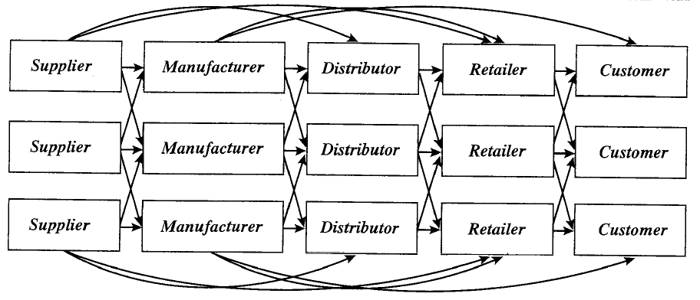
Figure 1-2

Slide 9
Objective of a Supply Chain
To maximize the overall value generated
Supply chain profitability(supply chain surplus)
= Customer value – Supply chain cost
Example: A customer purchases a wireless router from Best Buy for $60 (revenue).Supply chain incurs costs (information, storage, transportation, components, assembly, etc.). Difference between $60 and the sum of all of these costs is the supply chain profit.

Slide 10
Supply chain surplus - Total profit to be shared across all supply chain stages and intermediaries
The higher the supply chain profitability, the more successful is the supply chain
Supply chain success should be measured in terms of supply chain profitability and not in terms of the profits at an individual stage

Slide 11
For any supply chain, there is only one source of revenue: The customer
Other cash flows are simply fund exchanges that occur within the supply chain, given that different stages have different owners
All flows of information, product, or funds generate costs within the supply chain
Effective supply chain management involves the management of supply chain assets and product, information, and fund flows to maximize total supply chain profitability

Slide 12
Importance of Supply Chain Decisions
Wal-Mart, $1 billion sales in 1980 to $408 billion in 2010
Seven-Eleven Japan, ¥1 billion sales in 1974 to ¥3 trillion in 2009
Webvan folded in two years
Borders, $4 billion in 2004 to $2.8 billion in 2009
Dell, $56 billion in 2006, adopted new supply chain strategies

Slide 13
Decision Phases of a Supply Chain
Supply Chain Strategy or Design:
Time frame: Several years
It decides what the chain's configuration will be, how
resources will be allocated, and what processes each
stage will perform
Decisions are typically made for the long term and are very expensive to alter on short notice

Slide 14
Strategic supply chain decisions
Locations and capacities of facilities
Products to be made or stored at various locations
Modes of transportation
Information systems

Slide 15
2. Supply Chain Planning:
The goal is to maximize the supply chain surplus that can be generated over the planning horizon given the constraints established during the strategic or design phase
Planning phase starts with a forecast for the coming year
Establishes parameters within which a supply chain will function over a specified period of time
A set of operating policies that govern short-term operations are defined

Slide 16
Planning decisions:
Which markets will be supplied from which locations
Planned buildup of inventories
Subcontracting, backup locations
Inventory policies
Timing and size of market promotions

Slide 17
3. Supply Chain Operation:
Time frame: Weekly or daily, so less uncertainty
The goal is to handle incoming customer orders in the best possible manner for individual customer
Firms allocate inventory or production to individual orders
Set a date that an order is to be filled
Generate pick lists at a warehouse
Allocate an order to a particular shipping mode and shipment

Slide 18
Process View of a Supply Chain
Two different ways to view the processes
1.Cycle View: Processes in a supply chain are divided into a series of cycles, each performed at the interface between two successive stages
2. Push/Pull View: Processes in a supply chain are divided into two categories depending on whether they are executed in response to a customer order(pull) or in anticipation of customer orders(push)

Slide 19
Cycle View of Supply Chain Processes
All supply chain processes can be broken down into the following four process cycles
Customer order cycle
Replenishment cycle
Manufacturing cycle
Procurement cycle

Slide 20
Cycle View of Supply Chain Processes
Figure 1-3

Slide 21
Not every supply chain will have all four cycles clearly separated
Example:
A grocery supply chain in which a retailer stocks finished-goods inventories and places replenishment orders with a distributor is likely to have all four cycles separated
Whereas, Dell sells directly to customers, thus bypassing the retailer and distributor

Slide 22
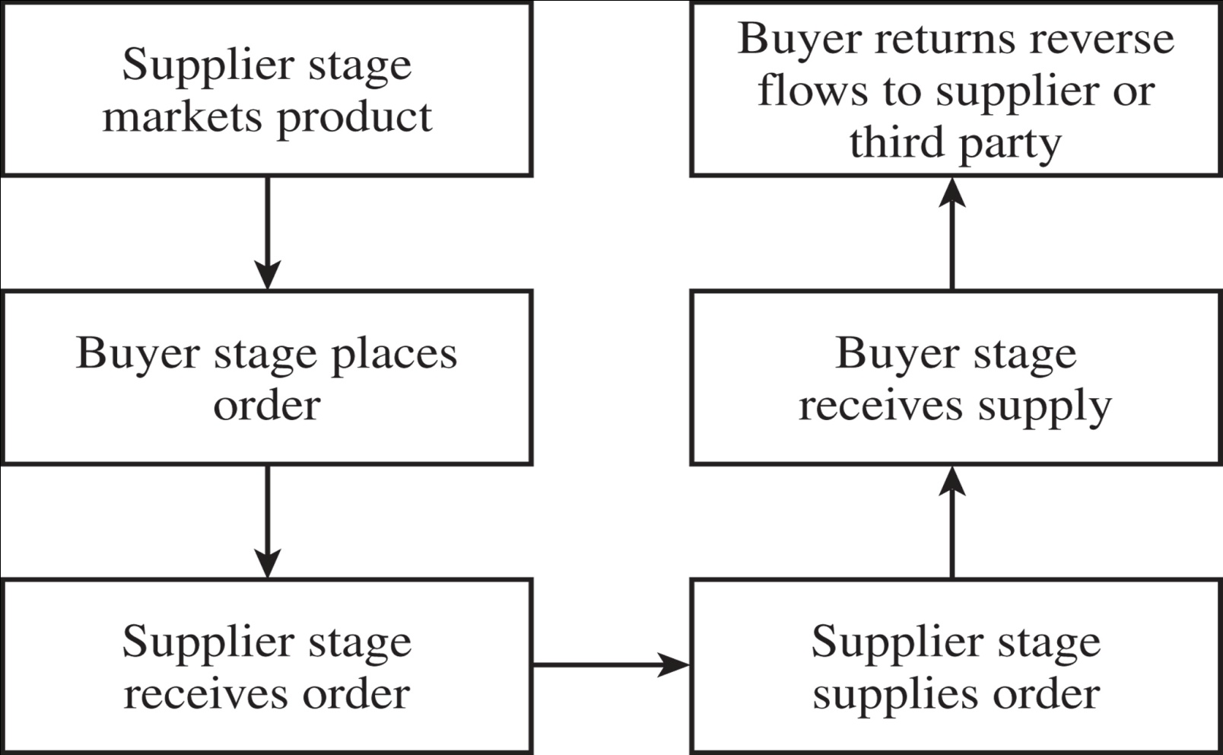
Each cycle consists of six subprocesses
Figure 1-4

Slide 23
Within each cycle, the goal of the buyer is to ensure product availability and to achieve economies of scale in ordering
Reverse flows are managed to reduce cost and meet environmental objectives

Slide 24
There are a few important differences between cycles
1. In the customer order cycle, demand is external to the supply chain and thus uncertain, in other stages order is uncertain but based on policies of previous stage
Example:
In the procurement cycle, a tire supplier to an automotive manufacturer can predict tire demand precisely once the production schedule at the manufacturer is known

Slide 25
2. The second difference across cycles relates to the scale of an order
As we move from the customer to the supplier, the number of individual orders declines and the size of each order increases
Example:
A customer buys a single car, the dealer orders multiple cars at a time from the manufacturer, and the manufacturer, in turn, orders an even larger quantity of tires from the supplier

Slide 26
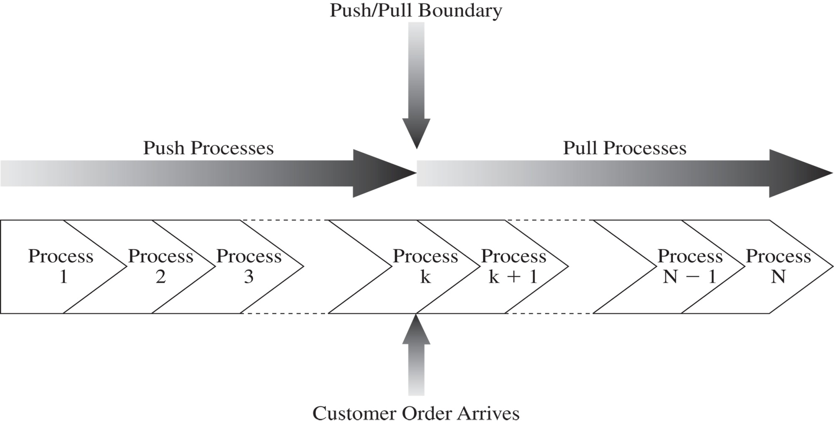
Push/Pull View of Supply Chains
Figure 1-5

Slide 27
Two categories of processes in supply chain
1. Pull processes, execution is initiated in response to a customer order.
Referred to as reactive processes because they react to customer demand
2. Push processes, execution is initiated in anticipation of customer orders
Referred to as speculative processes because they respond to speculated (or forecasted) rather than actual demand

Slide 28
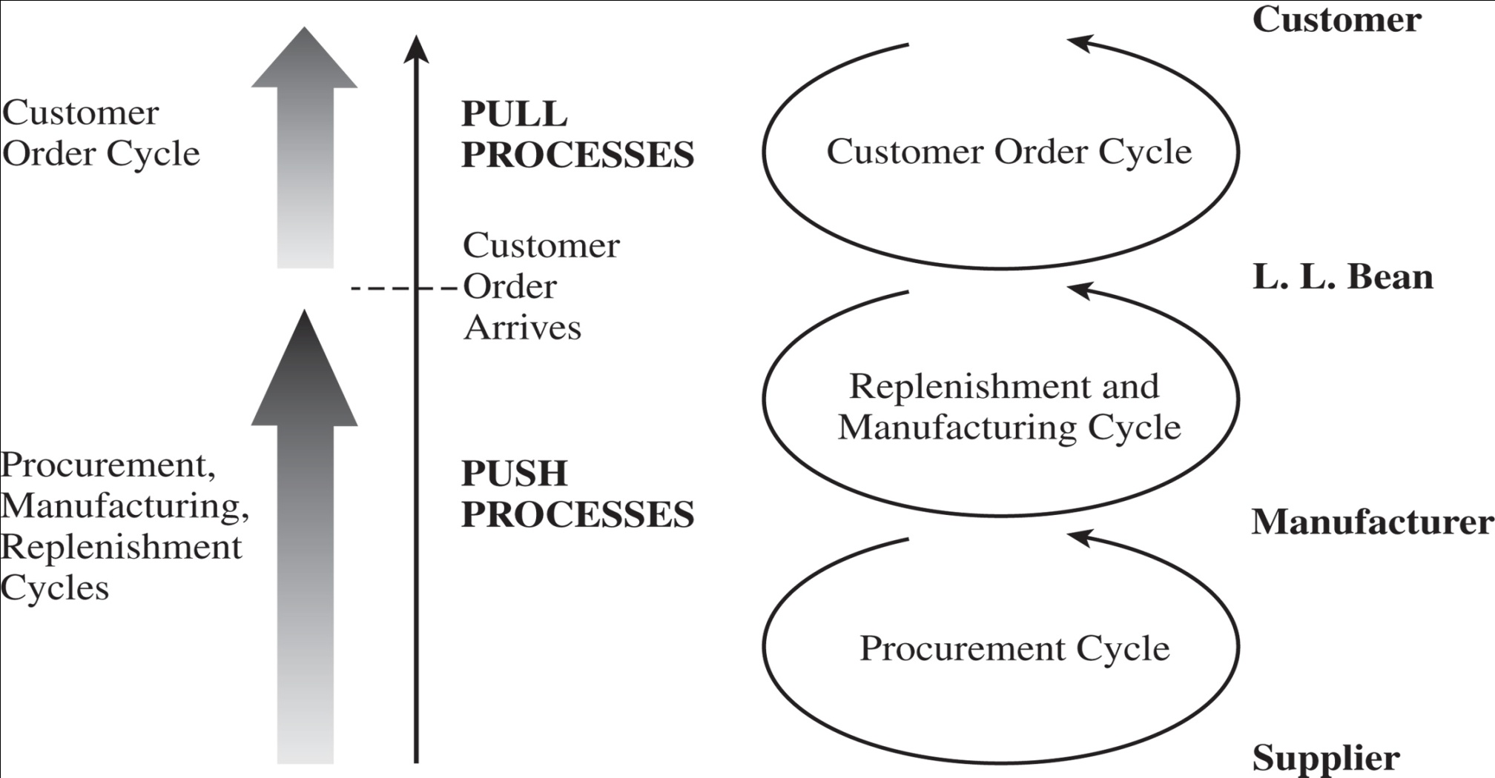
Push/Pull View—L.L. Bean
Figure 1-6

Slide 29
Push/Pull View—L.L. Bean
Make-to-stock environment
L.L.Bean executes all processes in the customer order cycle after the customer arrives
All processes that are part of the customer order cycle are pull processes
All processes in the replenishment , manufacturing and procurement cycle are performed in anticipation of demand and are thus push processes.

Slide 30
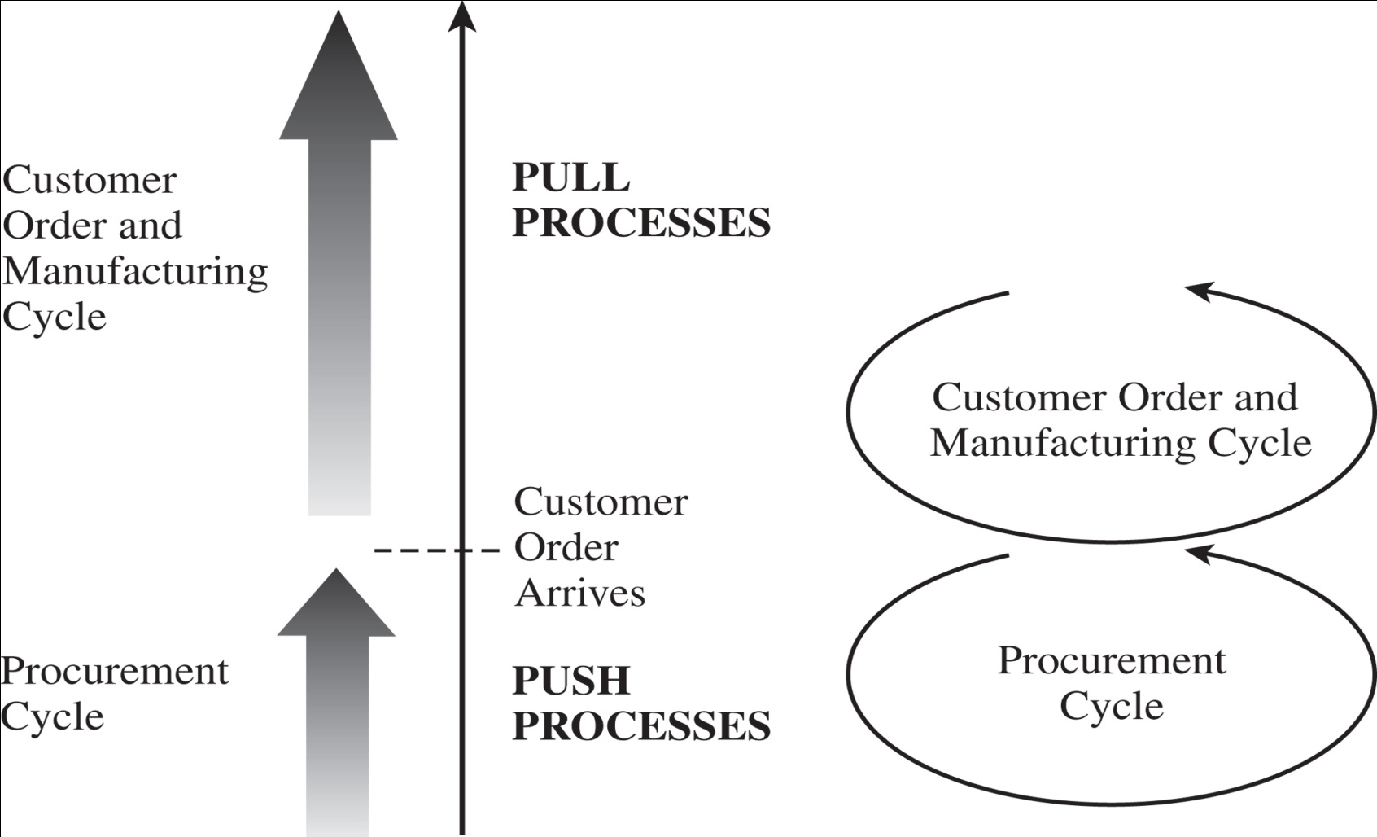
Push/Pull View—Dell
Figure 1-7

Slide 31
Push/Pull View—Dell
The arrival of a customer order triggers production of the product
Effectively only two cycles in the Dell supply chain:
(1) A customer order and manufacturing cycle(pull)
(2) A procurement cycle(push)

Slide 32
Example: Paint industry
In early days production of the base, mixing of suitable colours, and packing were performed in large factories and paint cans were shipped to stores(push)
Uncertainty- no match between supply and demand
Solution- Mixing of colours was done at retail stores after customers placed their orders (pull)

Slide 33
Supply Chain Macro Processes
Classification of supply chain processes
Customer Relationship Management (CRM): Focus on the interface between the firm and its customers
Internal supply chain management (ISCM):Processes that are internal to the firm
Supplier Relationship Management (SRM):Processes that focus on the interface between the firm and its suppliers

Slide 34
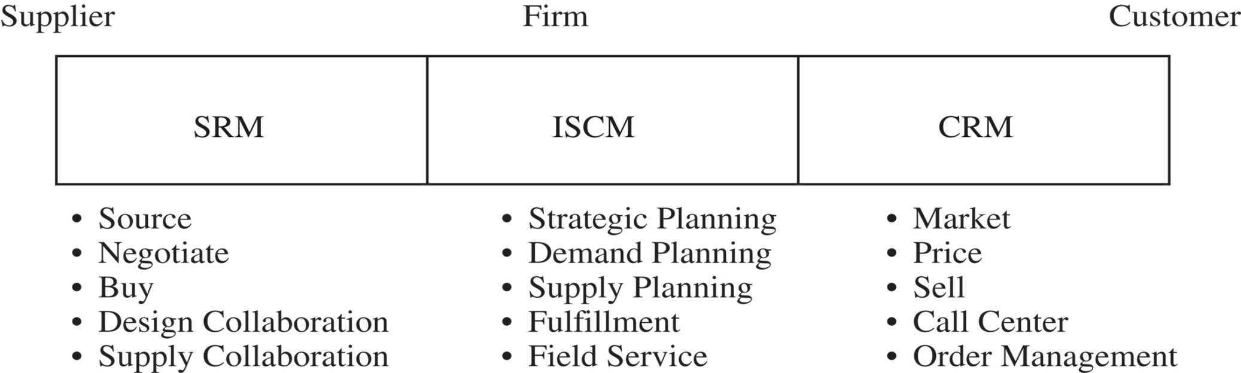
Supply Chain Macro Processes
Figure 1-8

Slide 35
1. Customer Relationship Management (CRM):
Aims to generate customer demand and facilitate the placement and tracking of orders
Marketing, pricing, sales, order management, and call center management,
Example: W.W. Grainger
Preparation of catalogues, management of the Web site, management of the call center

Slide 36
2. Internal supply chain management (ISCM):
Aims to fulfil demand generated by the CRM process in a timely manner and at the lowest possible cost
Planning of internal production and storage capacity, preparation of demand and supply plans, and fulfilment of actual orders
Example: W.W. Grainger
planning for the location and size of warehouses, picking, packing, and shipping actual orders

Slide 37
3.Supplier Relationship Management (SRM):
Aims to arrange for and manage supply sources for various goods and services
include the evaluation and selection of suppliers,
negotiation of supply terms, communication regarding new products
Example: W.W. Grainger
Selection of suppliers for various products, sharing of demand and supply plans, placement of replenishment orders

Slide 38
Examples of Supply Chains
Gateway
Zara
W.W. Grainger and McMaster-Carr
Toyota
Amazon
Gopaljee

Slide 39
Gateway: A direct sales manufacturer
Why did Gateway choose not to carry any finished-product inventory at its retail stores? Why did Apple choose to carry inventory at its stores?
Should a firm with an investment in retail stores carry any finished-goods inventory? What are the characteristics of products that are most suitable to be carried in finished-goods inventory? What characterizes products that are best manufactured to order?
How does product variety affect the level of inventory that a retail store must carry?
Is a direct selling supply chain without retail stores always less expensive than a supply chain with retail stores?
What factors explain the success of Apple retail and the failure of Gateway country stores?

Slide 40
Zara: Apparel manufacturing & retail
What advantage does Zara gain against the competition by having a very responsive supply chain?
Why has Inditex chosen to have both in-house manufacturing and outsourced manufacturing? Why has Inditex maintained manufacturing capacity in Europe even though manufacturing in Asia is much cheaper?
Why does Zara source products with uncertain demand from local manufacturers and products with predictable demand from Asian manufacturers?
What advantage does Zara gain from replenishing its stores multiple times a week compared to a less frequent schedule? How does the frequency of replenishment affect the design of its distribution system?
Do you think Zara’s responsive replenishment infrastructure is better suited for online sales or retail sales?

Slide 41
W.W. Grainger and McMaster-Carr
How many DCs should be built and where should they be located?
How should product stocking be managed at the DCs? Should all DCs carry all products?
What products should be carried in inventory and what products should be left with the supplier to be shipped directly in response to a customer order?
What products should W.W. Grainger carry at a store?
How should markets be allocated to DCs in terms of order fulfillment? What should be done if an order cannot be completely filled from a DC? Should there be specified backup locations? How should they be selected?
Contd…

Slide 42
W.W. Grainger and McMaster-Carr
How should replenishment of inventory be managed at the various stocking locations?
How should Web orders be handled relative to the existing business? Is it better to integrate the Web business with the existing business or to set up separate distribution?
What transportation modes should be used for order fulfillment and stock replenishment?

Slide 43
Toyota: A global auto manufacturer
Where should plants be located, what degree of flexibility and what capacity should each have?
Should plants be able to produce for all markets?
How should markets be allocated to plants?
What kind of flexibility should be built into the distribution system?
How should this flexible investment be valued?
What actions may be taken during product design to facilitate this flexibility?

Slide 44
Amazon.com: An E-business
Why is Amazon building more warehouses as it grows? How many warehouses should it have and where should they be located?
What advantages does selling books via the Internet provide over a traditional bookstore? Are there any disadvantages to selling via the Internet?
Should Amazon stock every product it sells?
What advantage can bricks-and-mortar players derive from setting up an online channel? How should they use the two channels to gain maximum advantage?
What advantages/disadvantages does the online channel enjoy in the sale of shoes (diapers) relative to a retail store?
For what products does the online channel offer the greater advantage relative to retail stores? What characterizes these products?

Slide 45
Gopaljee: Transforming Traditional Supply Chain
How can Gopaljee’s supply and distribution model be extended to other business lines in the Indian and South Asian context?
What all socio-economic features of South Asian societies can be identified as the foundations for building sustainable supply chains?
How can the existing distribution channels in the South Asian region be transformed to maximize the value delivered to the customer?
How can such indigenously developed SCM models integrate with and expand into global supply chains?

Slide 46
Summary of Learning Objectives
Discuss the goal of a supply chain and explain the impact of supply chain decisions on the success of a firm.
Identify the three key supply chain decision phases and explain the significance of each one.
Describe the cycle and push/pull views of a supply chain.
Describe the cycle and push/pull views of a supply chain.

